Slide 1

Development of a Cloud-Based System to Facilitate Software Project Tracking and Collaboration
Research Project Final Defense
Student ID: CSE 202401053
Name: Aulad Hossen
Intake: Spring 2024
Presenter
Notes:
NOTE:
To change the image on this slide, select the picture and delete it. Then click the Pictures icon in the placeholder to insert your own image.

Slide 2

Content
1
Introduction
2
Literature Review
3
Problem Statement
4
System Design
5
User Interface & Features
6
Implementation
7
Testing & Debugging
8
Deployment & Hosting
9
Results & Findings
10
Conclusion & Future Work

Slide 3
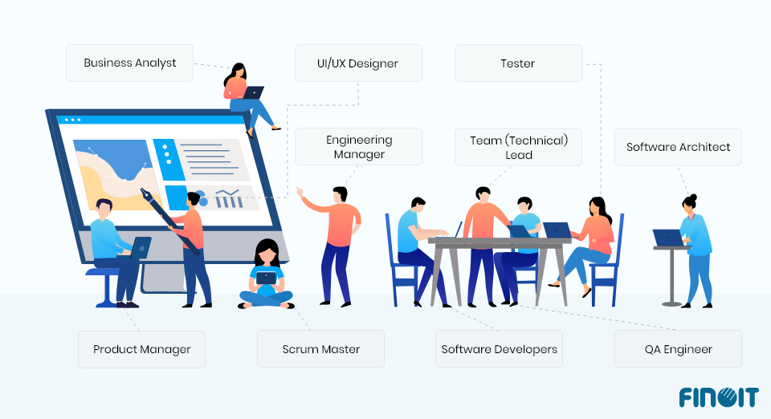
Introduction
Background
Modern challenges:
Distributed teams, Methodology Evolution, Tool Fragmentation, Information Silos, knowledge loss, Inadequate visibility for stakeholders
Motivation
Productivity Enhancement, Quality Improvement, Knowledge preservation, Alignment Improvement, Technological Evolution

Slide 4

Introduction
Project Scope
Key Objectives
Cloud-based system for entire software development lifecycle
Agile Methodology
Unified platform for project management and collaboration
Interfaces for different stakeholders
Cross-platform application
Support teams of smaill & mid sizes
Secure Role-Based Access Control
Streamlined Project Tracking
Enhanced Team Collaboration
Integrated GitHub Version Control
AI-Powered Analytical Insights
Transparent Progress Monitoring
Support for Multi-User Concurrency
Intuitive and Responsive User Interface

Slide 5
Literature Review
Tools like Jira, Trello, Asana support task tracking and collaboration.
Research systems focus on code sharing, communication, not full project management.
Existing tools lack role-specific features and custom workflows for small teams
Agile SDLC: Iterative development with feedback.
Scrum Framework: Roles (Scrum Master, Developer), Sprints, Backlog.
Role-Based Access Control: Manages feature access by user role.
MVC Architecture: Structured code separation (Model-View-Controller).
Overview of Existing System
Relevant Theories & Frameworks

Slide 6
Literature Review
Tailored for small teams and startup.
Adds GitHub integration for repo creation and tracking.
Client feedback loop feeds into backlog and sprint planning.
Custom role management and report generation not available in most free tools.
Generic and costly platforms with limited free access.
Lack of custom role-based workflows.
No integrated feedback-to-backlog pipeline.
Limited GitHub automation support.
Poor fit for small or mid-size project teams.
Extension and Contribution of This Study
Limitations in Current Solutions

Slide 7
Problem Statement
Current Challenges
Why important?
Fragmented Workflows
Lack of Real-Time Visibility
Poor Communication and Collaboration
Inefficient Task Management
Difficulty in Tracking Dependencies
Difficulty in Managing Remote Teams
Inadequate Feedback Mechanisms
Difficulty in Measuring Team Performance
Inefficient Time Tracking
Poor Onboarding for New Team Members
Direct impact on project outcomes:
Delays and budget overruns
Quality issues from miscommunication
Low team morale from administrative burden
Difficult knowledge transfer
Inconsistent stakeholder reporting
Critical need for cohesive tools in distributed
environments

Slide 8

Problem Statement
What Gap Does The System Fill?
Centralized Project Workspace
Real-Time Project Insights
Built-in Team Communication
Role-Based Task Management
Project Knowledge Repository
Automated Report Generation
End-to-End Traceability
Smart Resource Allocation
External Tool Integration
Proactive Alerts and Notifications

Slide 9
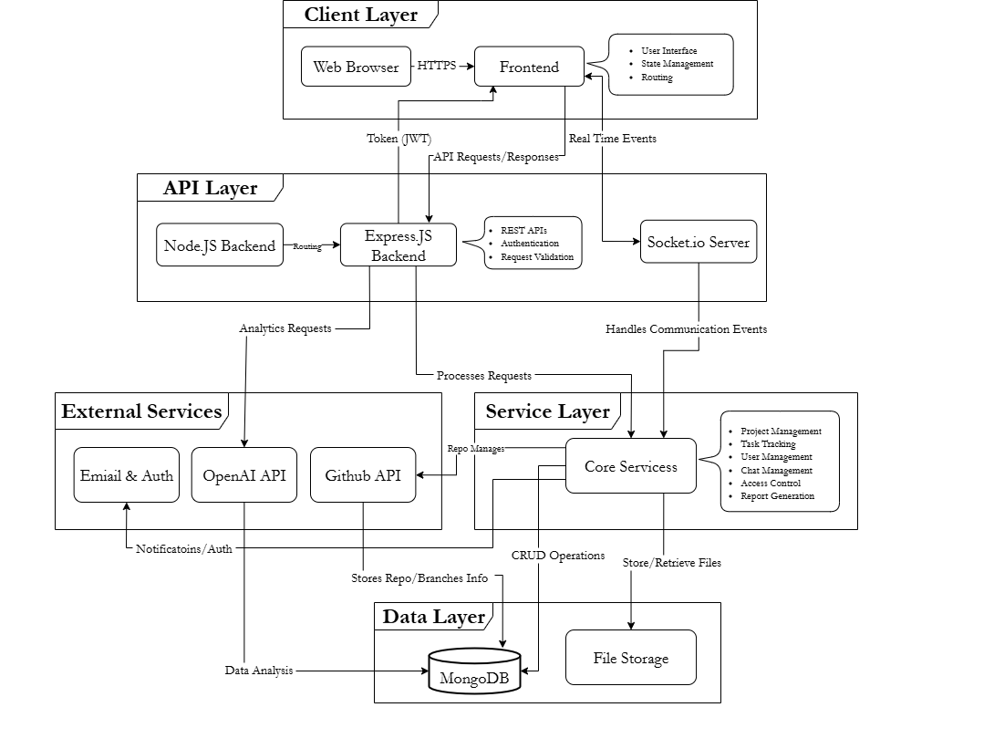
System Design
System Architecture

Slide 10
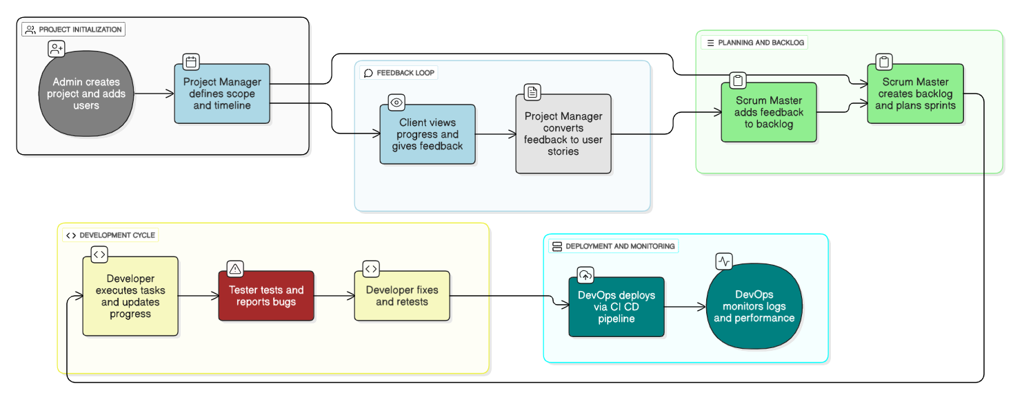
System Design
Swimlane Diagram

Slide 11
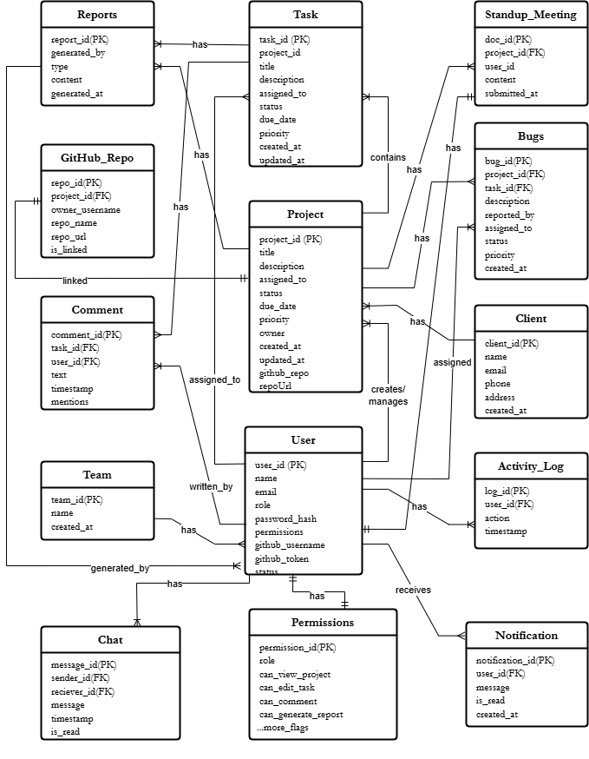
System Design
ER Diagram

Slide 12
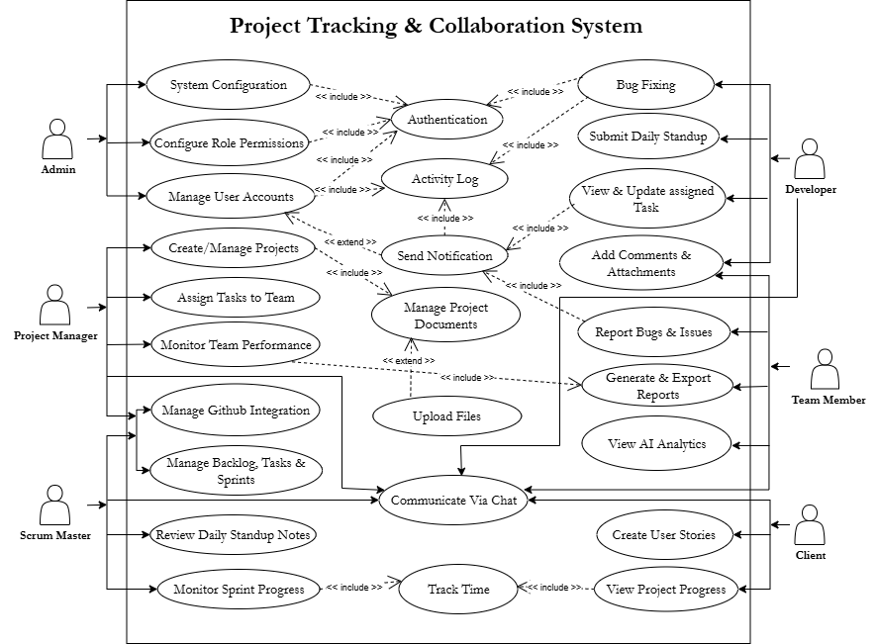
System Design
Use Case Diagram

Slide 13
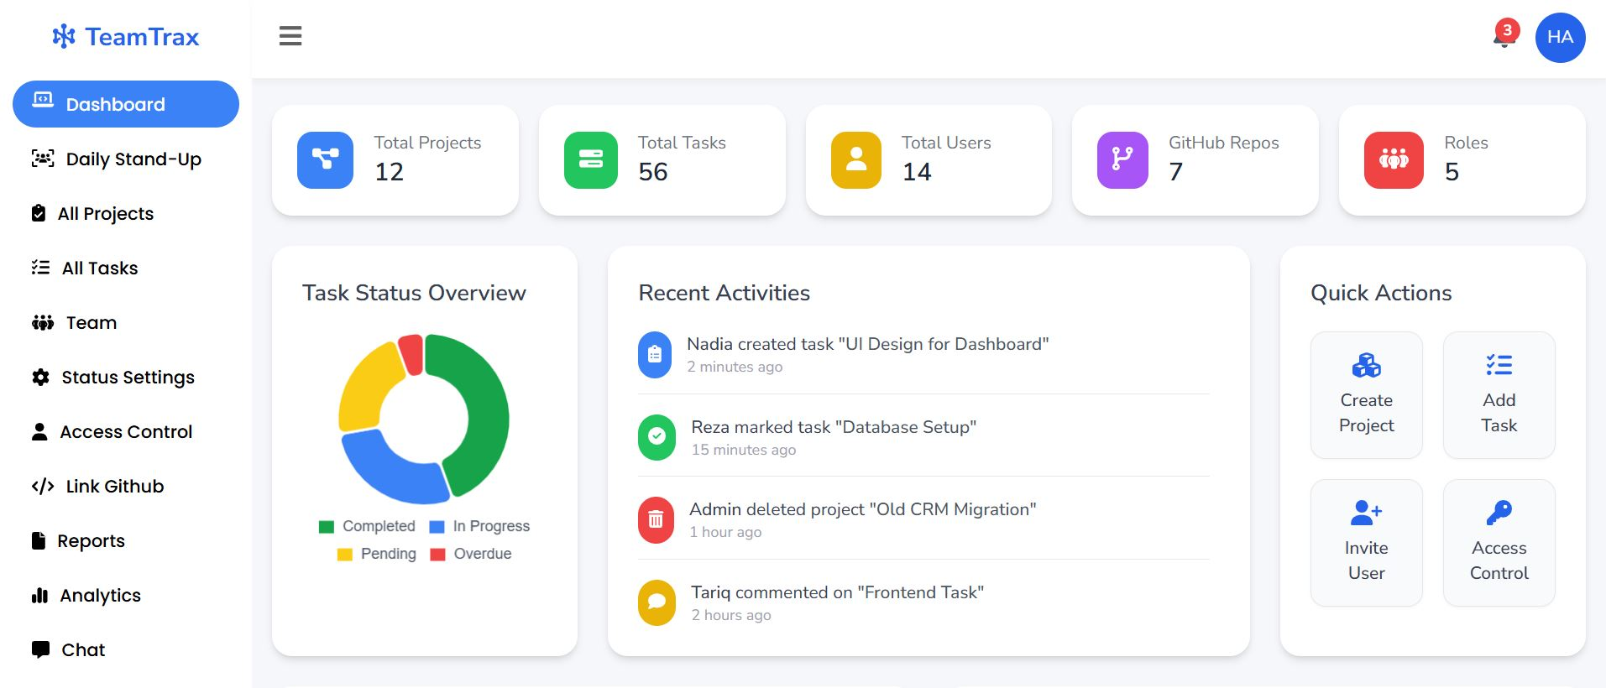
User Interface & Features
Admin Dashboard

Slide 14
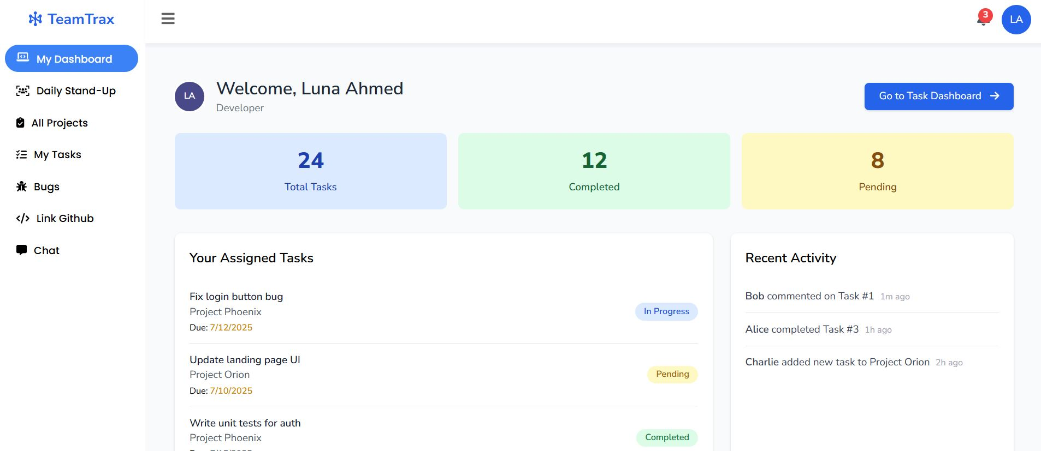
User Interface & Features
User Dashboard

Slide 15
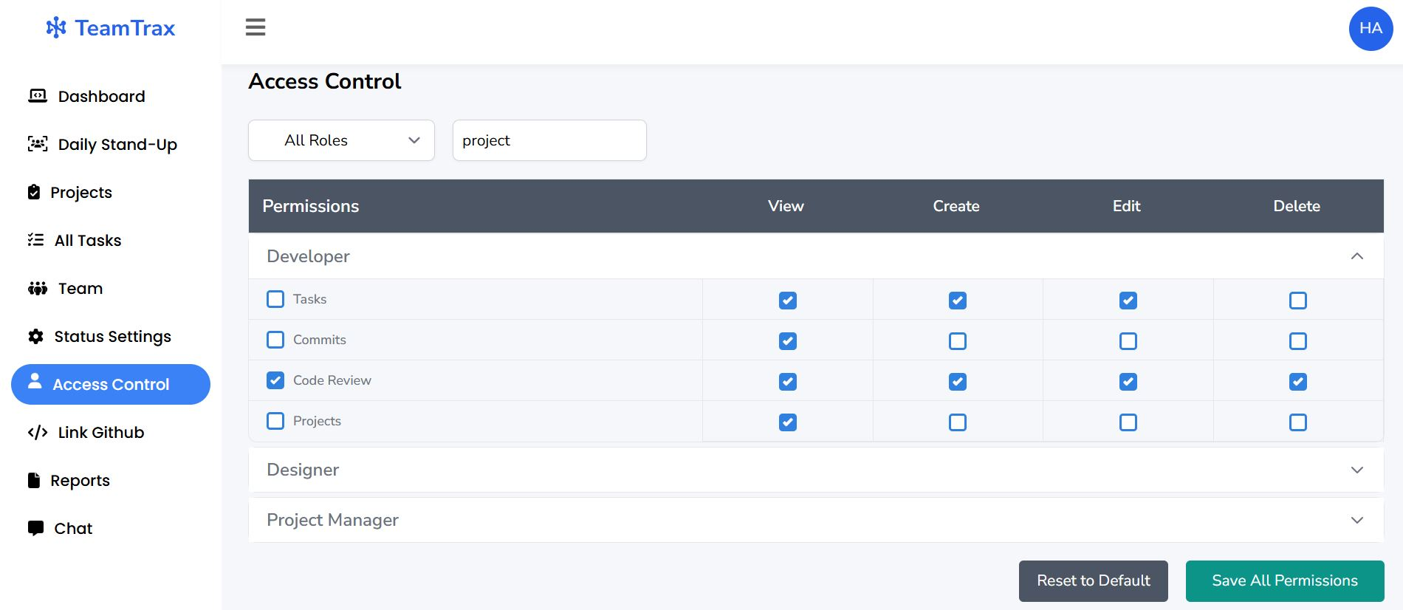
User Interface & Features
Access Control

Slide 16
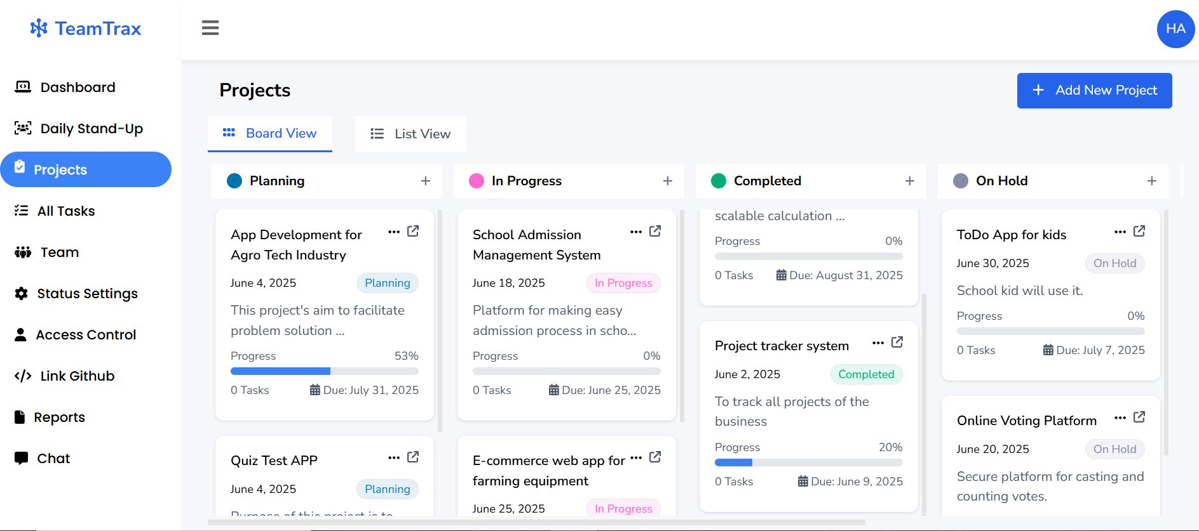
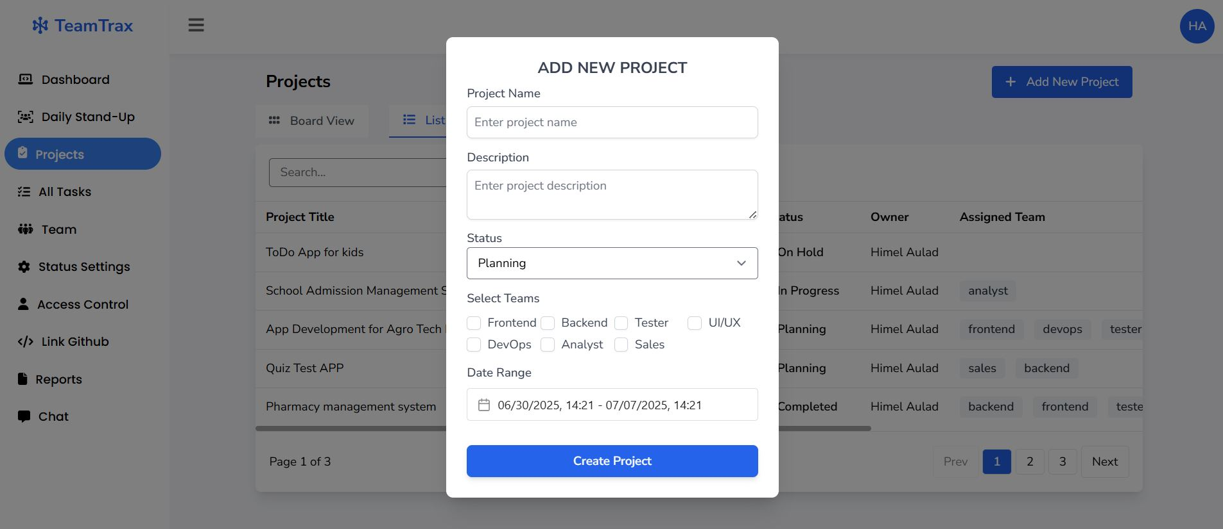
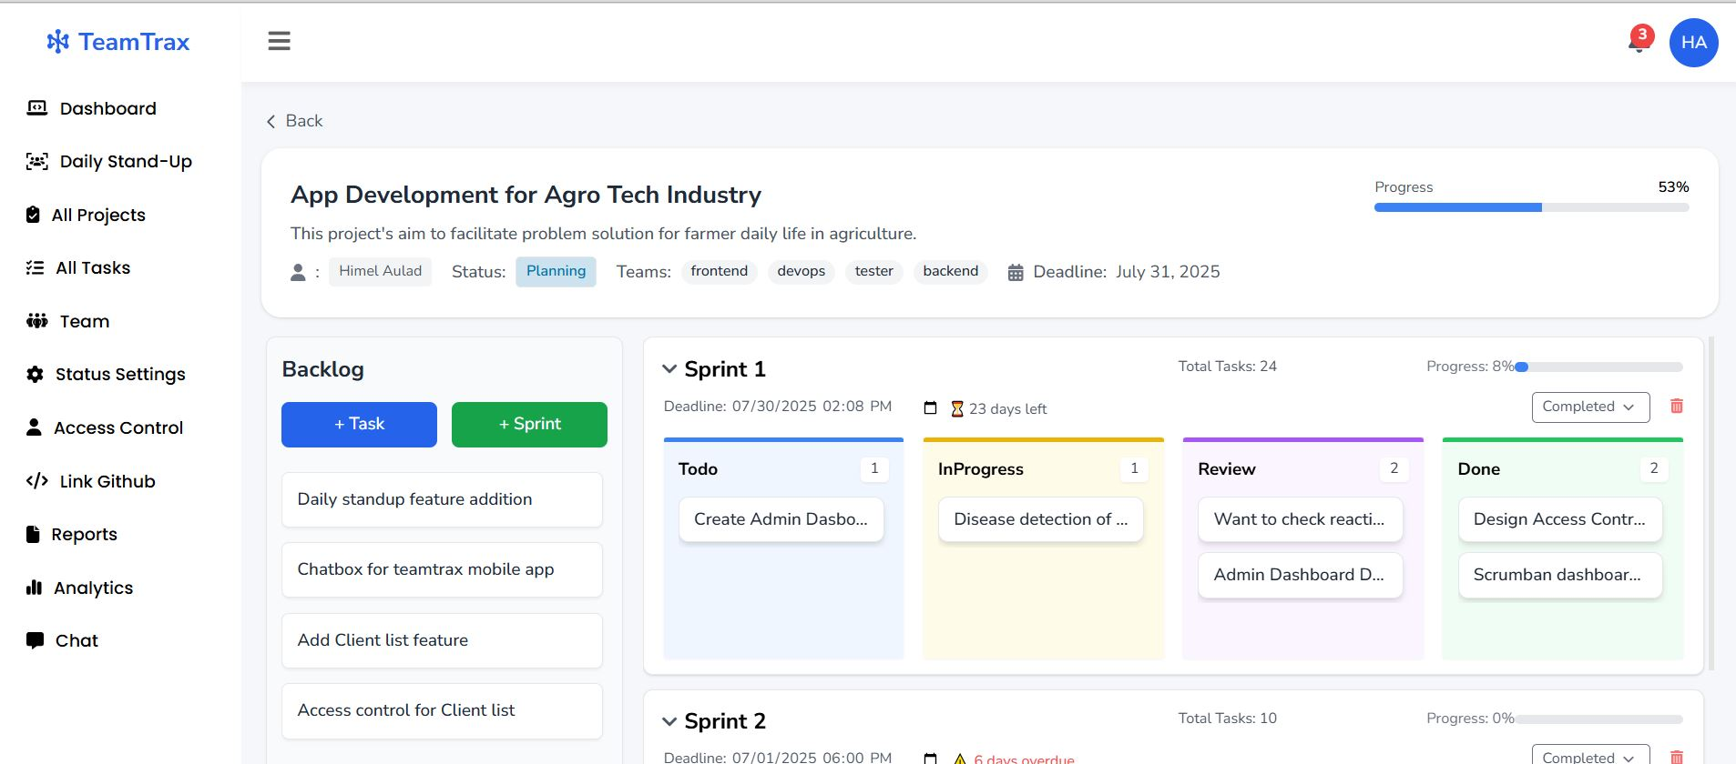
User Interface & Features
Project Board & Details Page
Project Creation Modal
Project Module

Slide 17
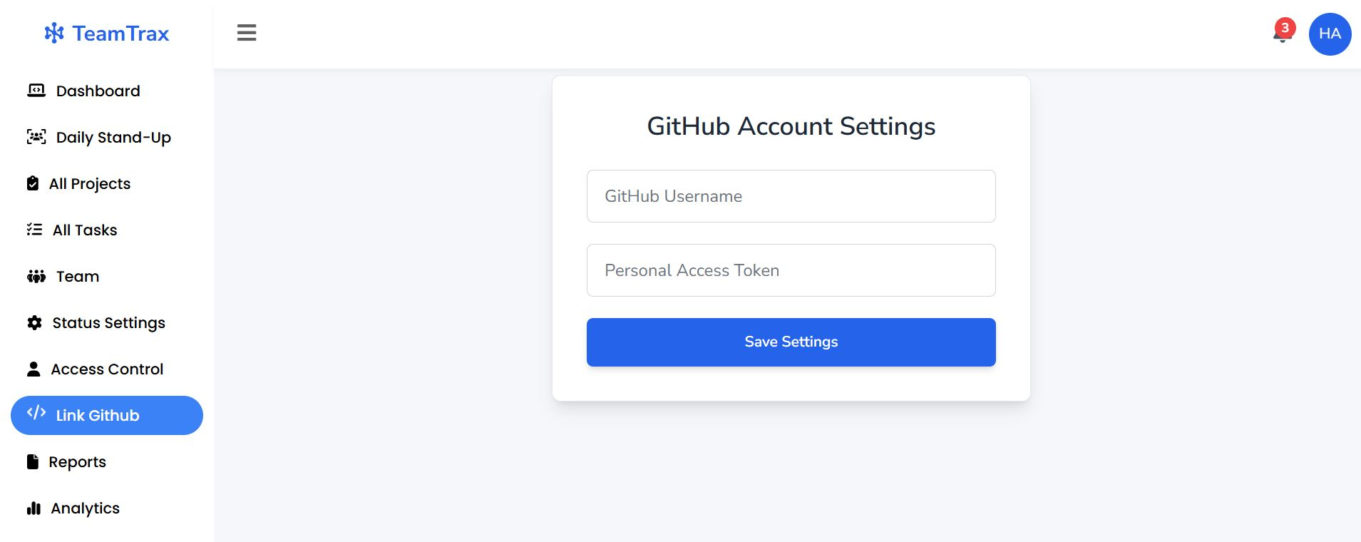
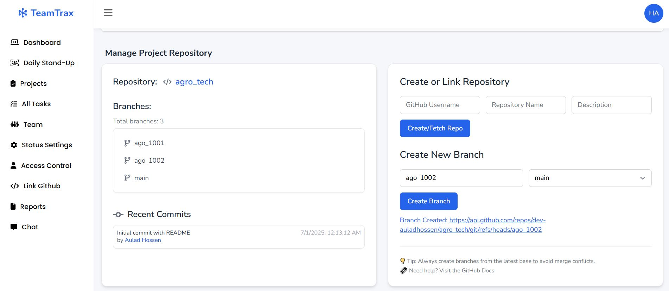
User Interface & Features
Github Linked Page
Github Repository/Branch manage Section
Github Module

Slide 18
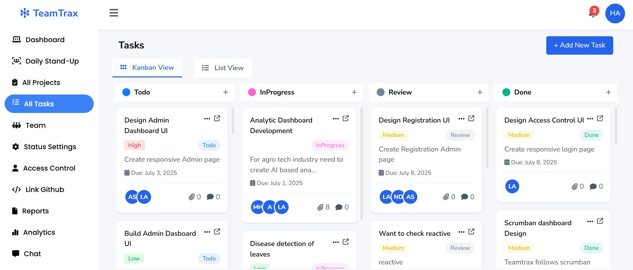
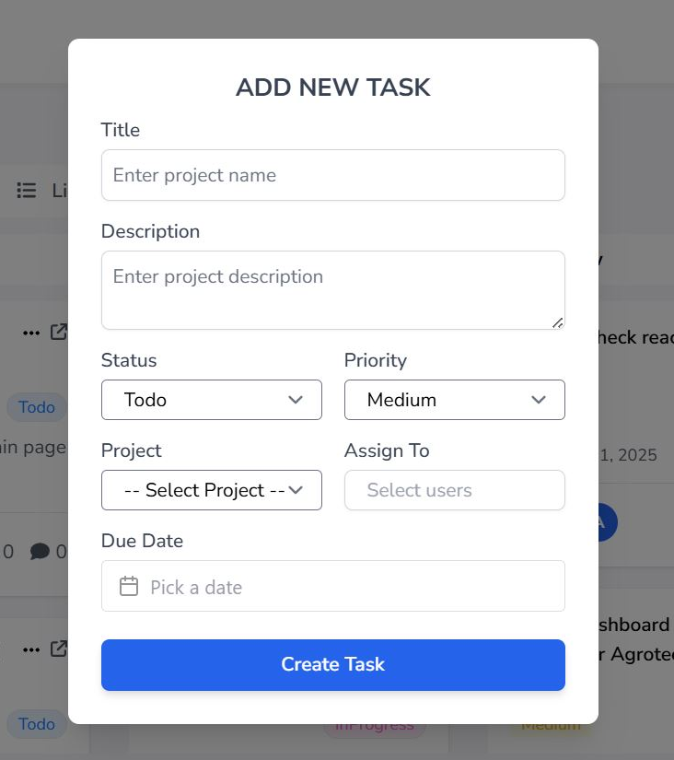
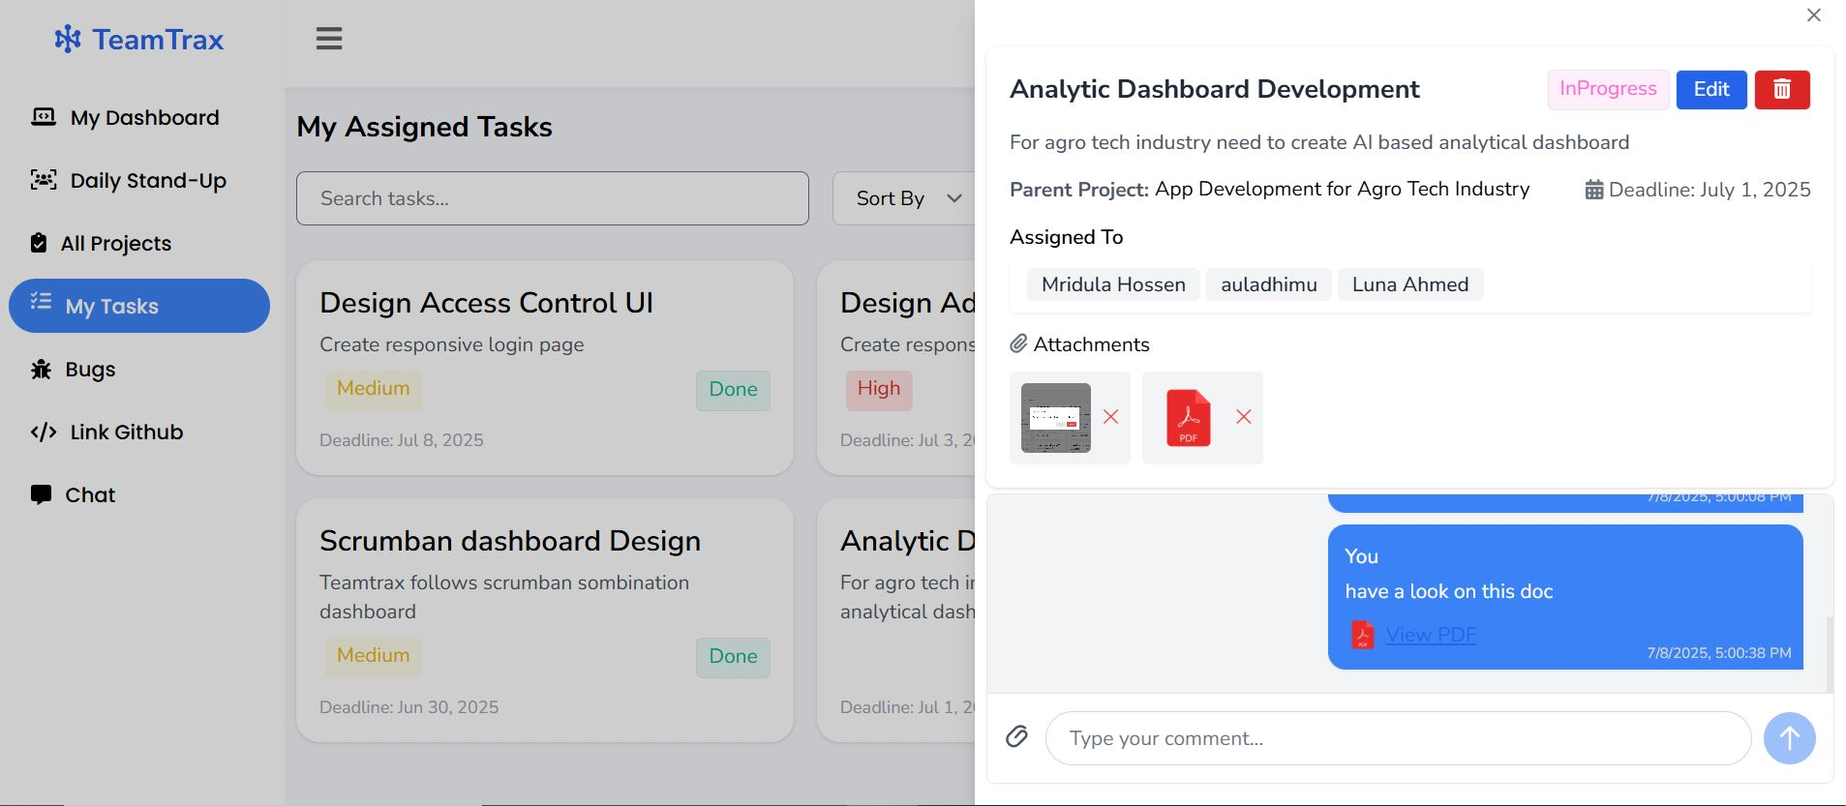
User Interface & Features
Task Board & Details Page
Task Creation Modal
Task Module

Slide 19
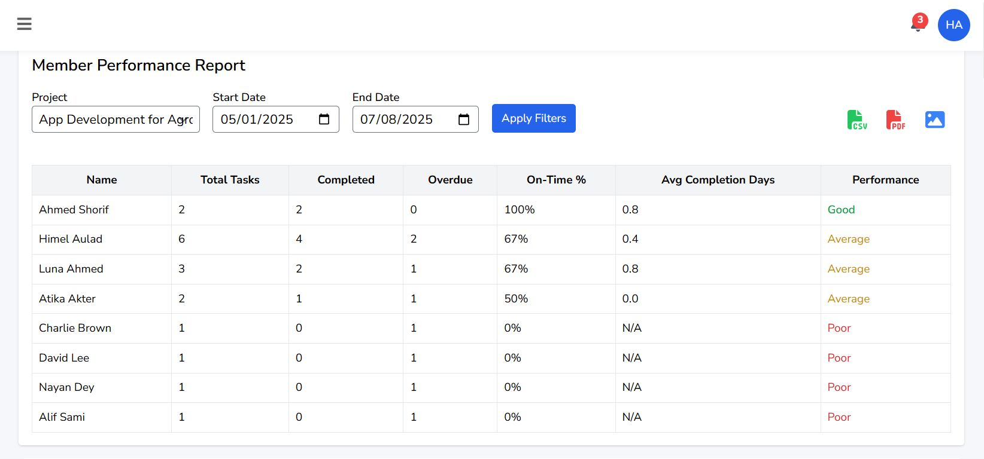
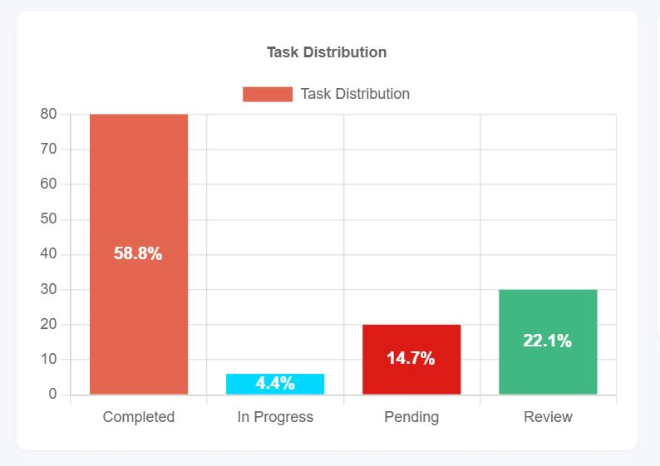
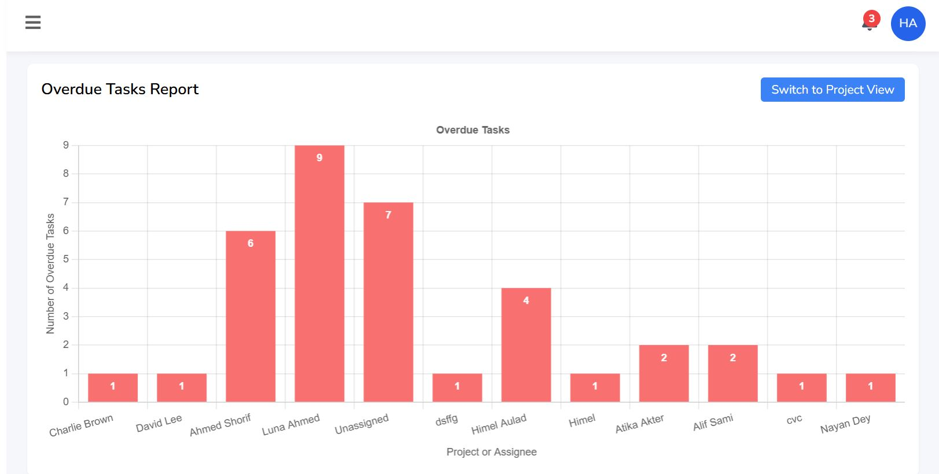
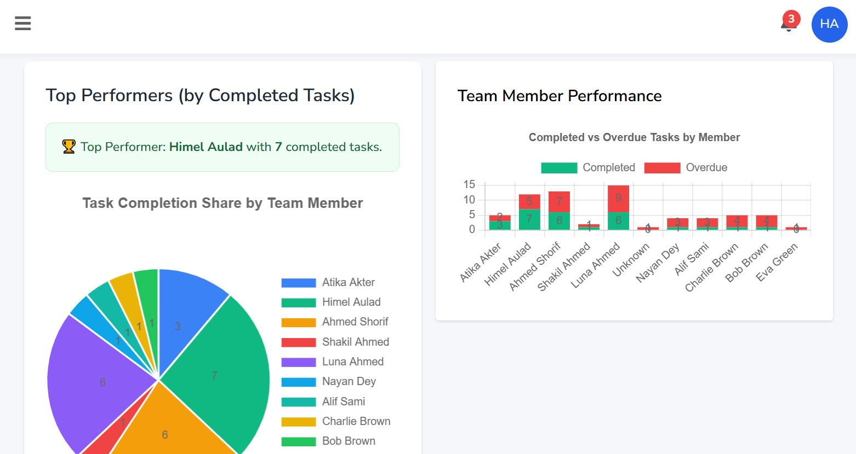
User Interface & Features
Report Module

Slide 20
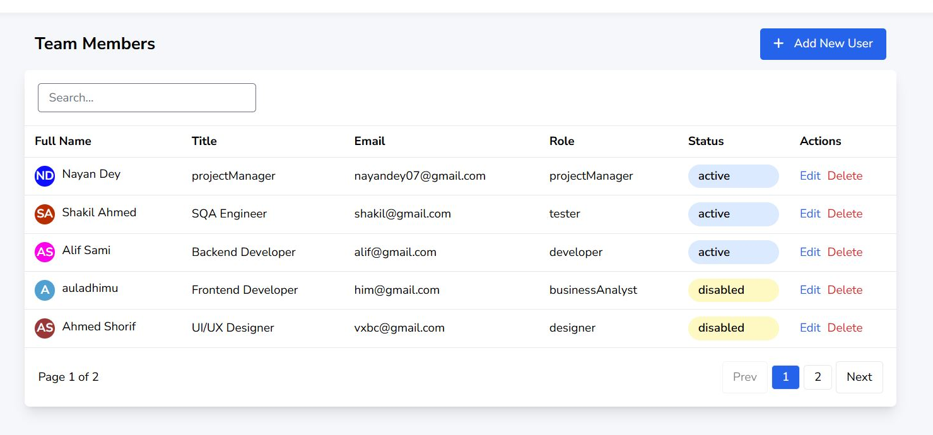
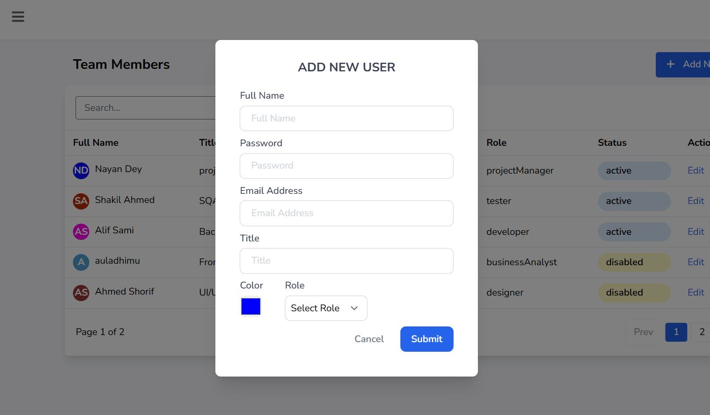
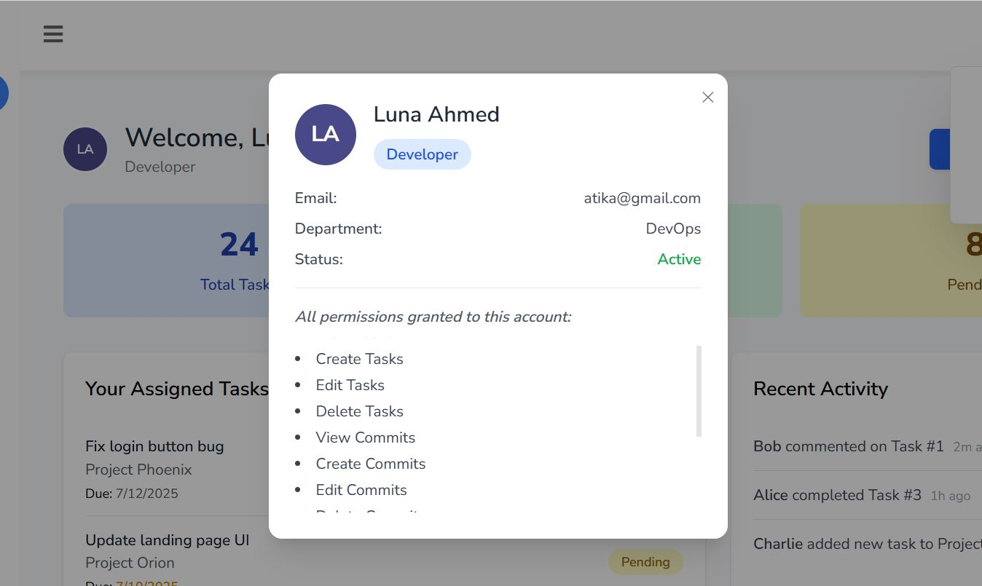
User Interface & Features
Team Module
Add New User Modal
User Profile
Team Members

Slide 21
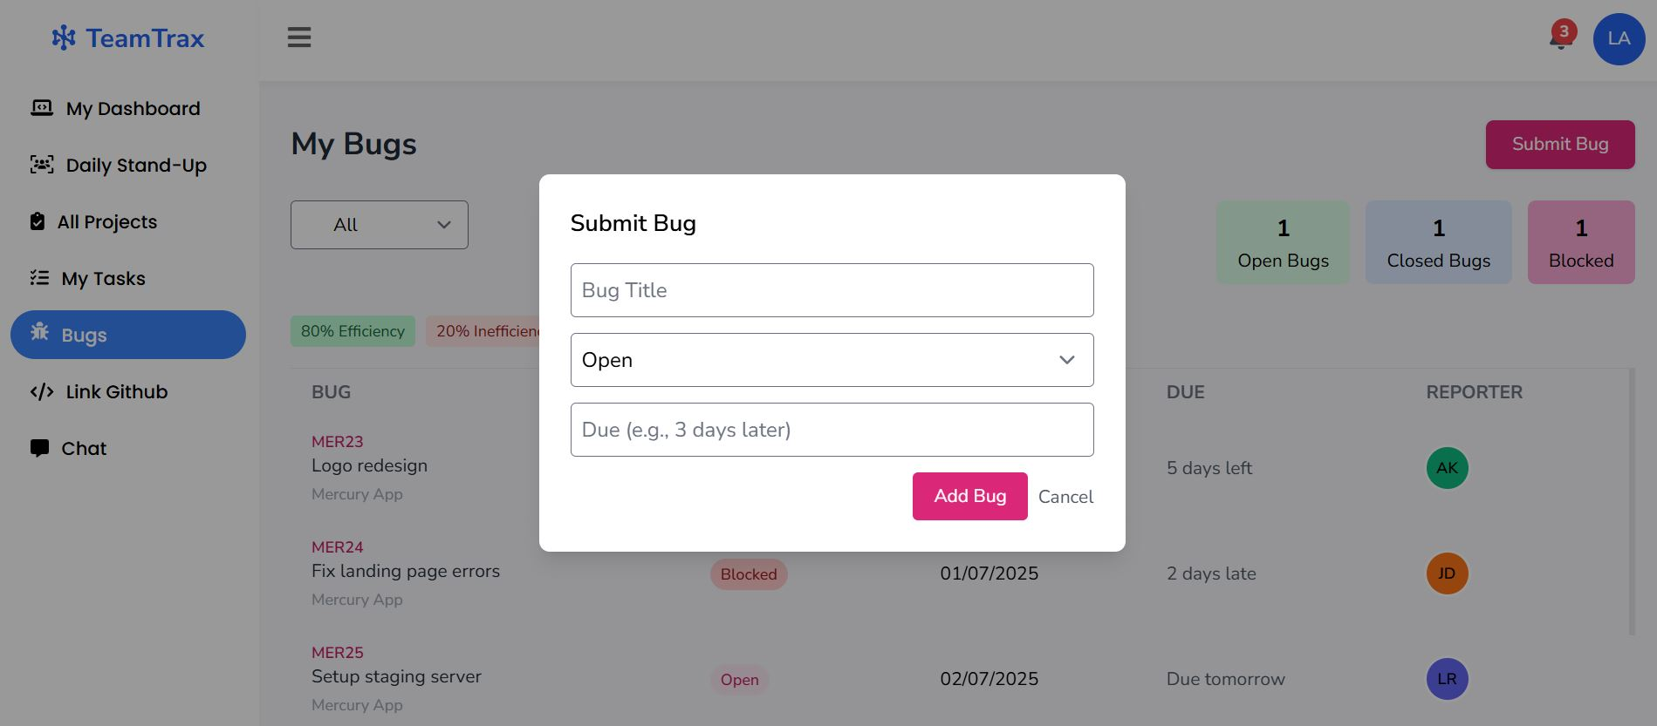
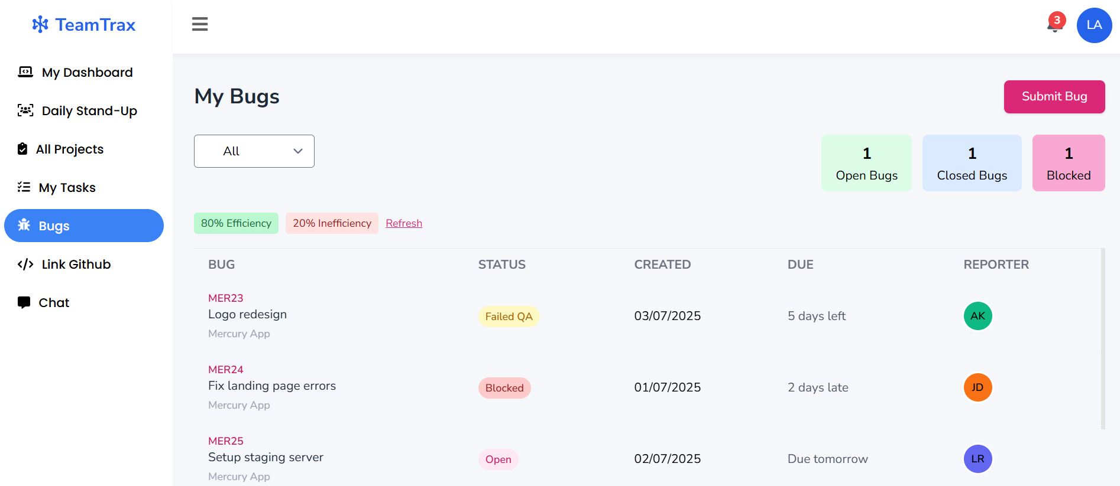
User Interface & Features
Bug & Issues Module
Report Bug/Issues Form
Reported Bugs/Issues List

Slide 22
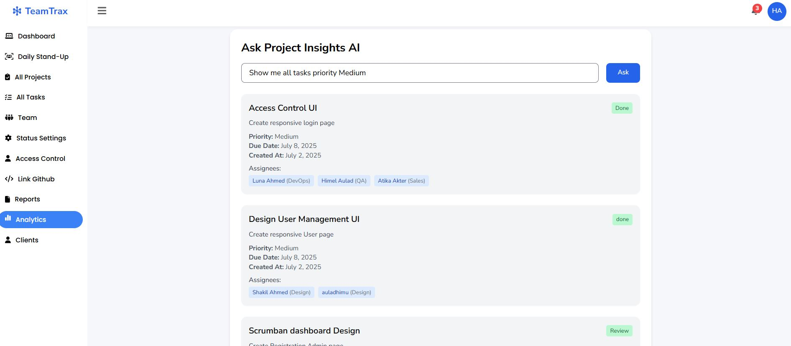
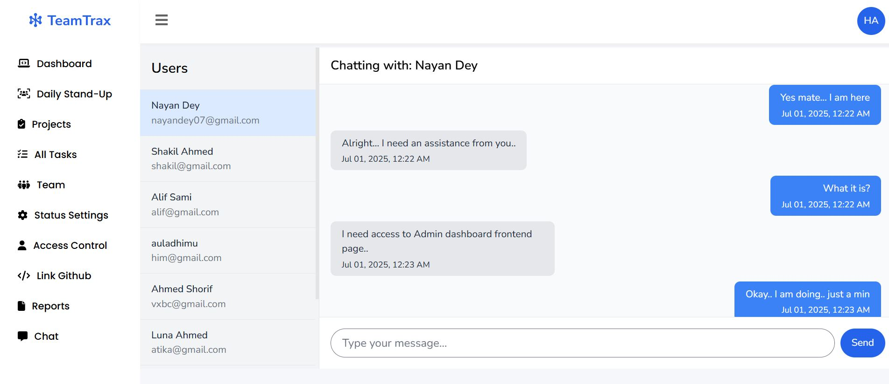
User Interface & Features
AI Analytics Page
Chatbox UI

Slide 23
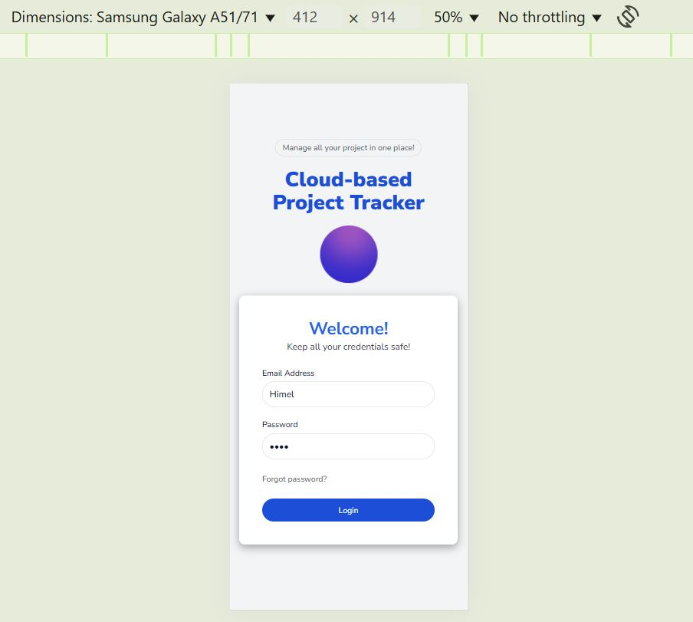
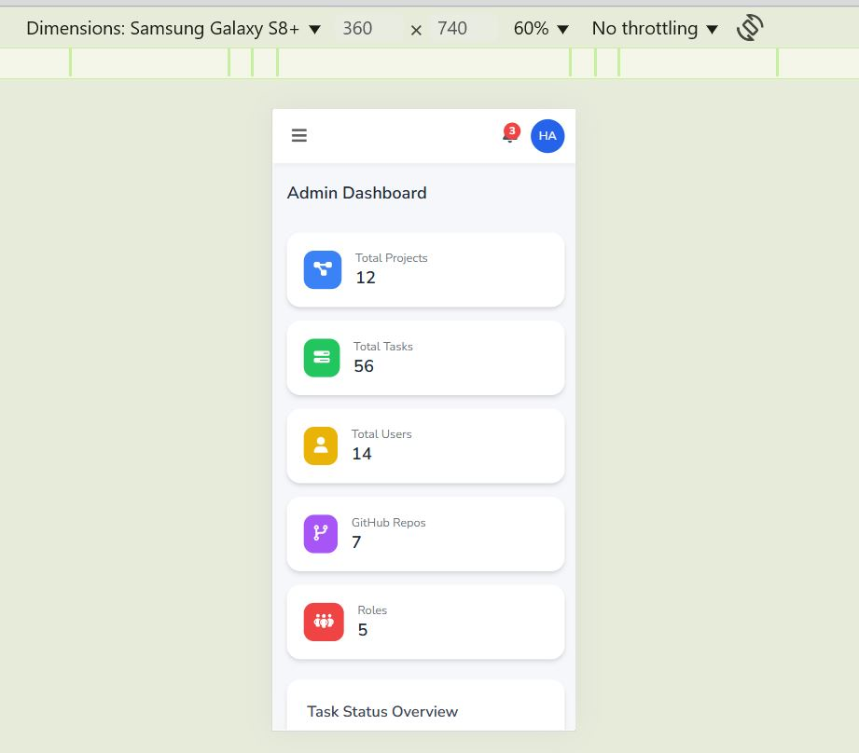
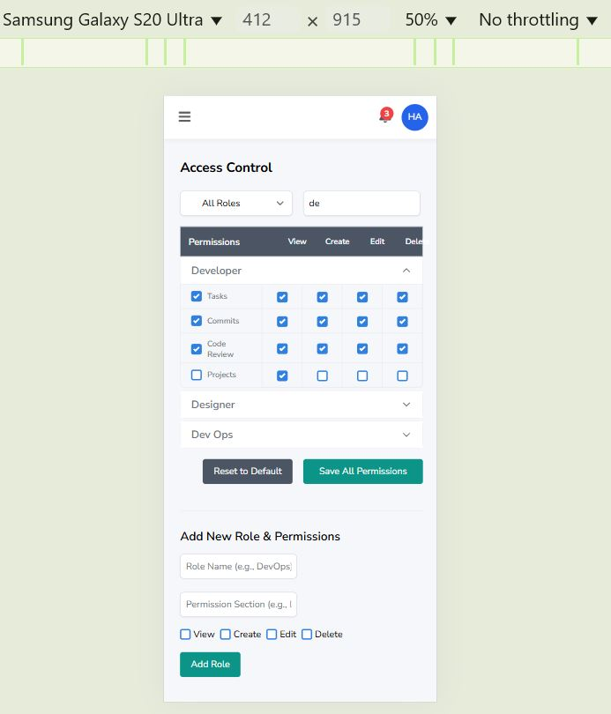
User Interface & Features
Responsive UI
Login Page
Admin Dashboard
Access Control Page

Slide 24
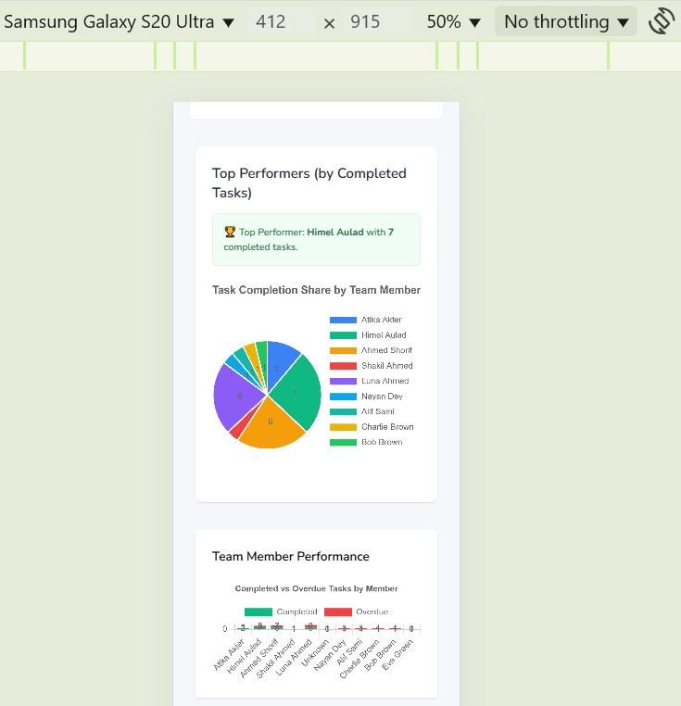
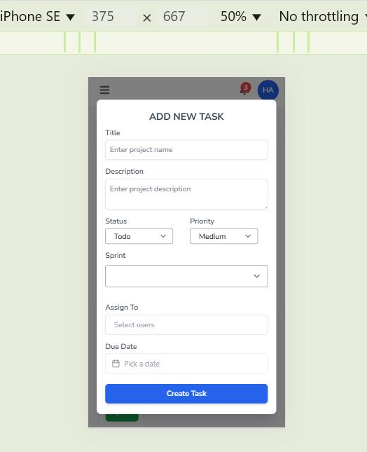
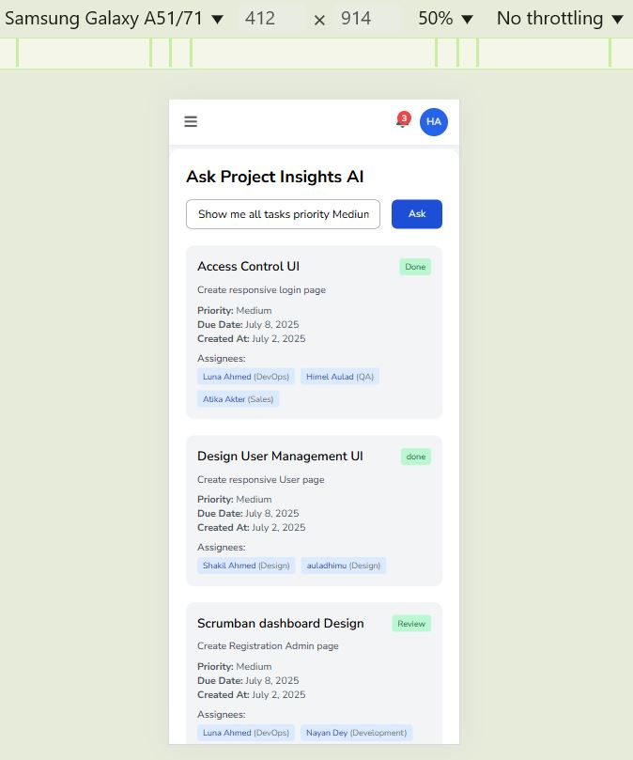
User Interface & Features
Responsive UI
Report Page
Create Task Modal
AI Analytics Board

Slide 25
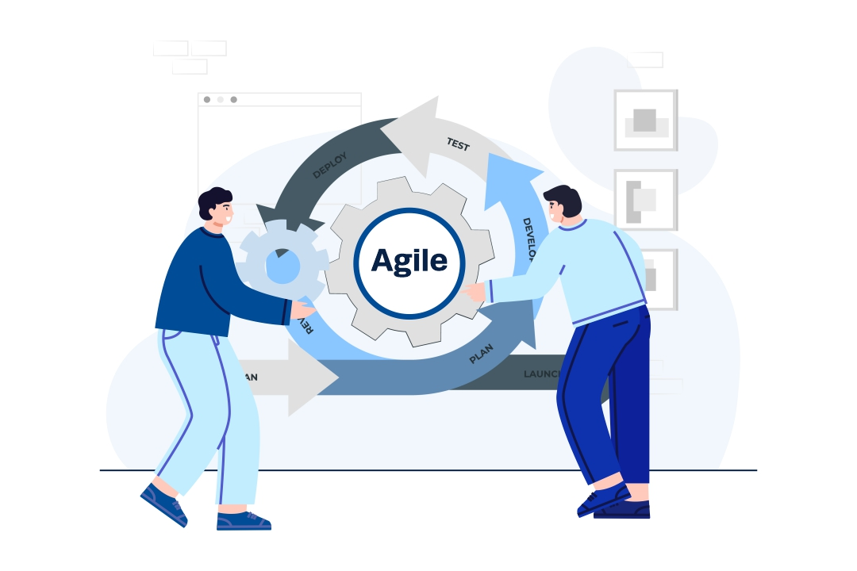
Implementation
Development
Methodology
Agile/Scrum approach
Kanban combined with incremental Process model
Short 1-2 week sprints
Daily personal review sessions
Adaptable to changing requirements
Track progress continuously
Get feedback on each increment

Slide 26
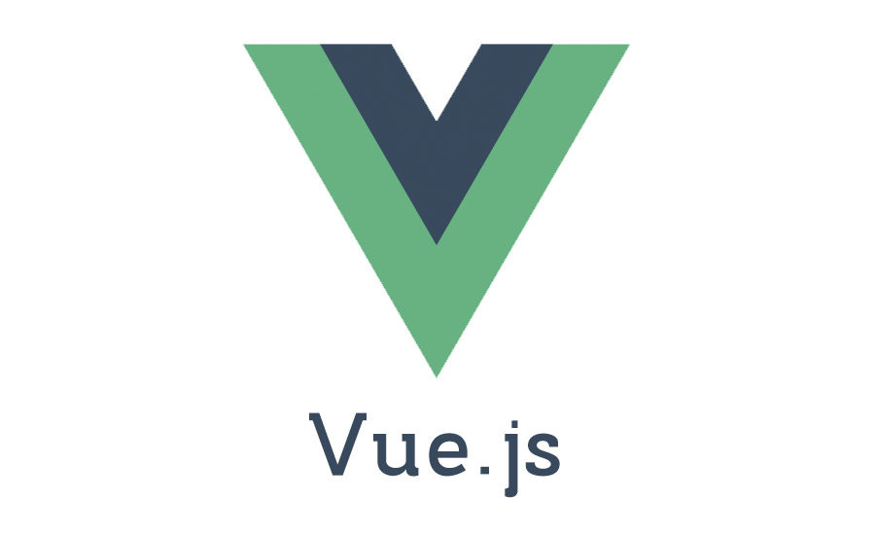


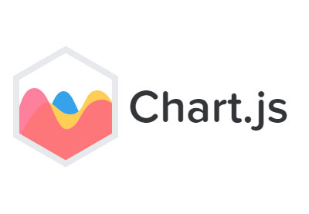



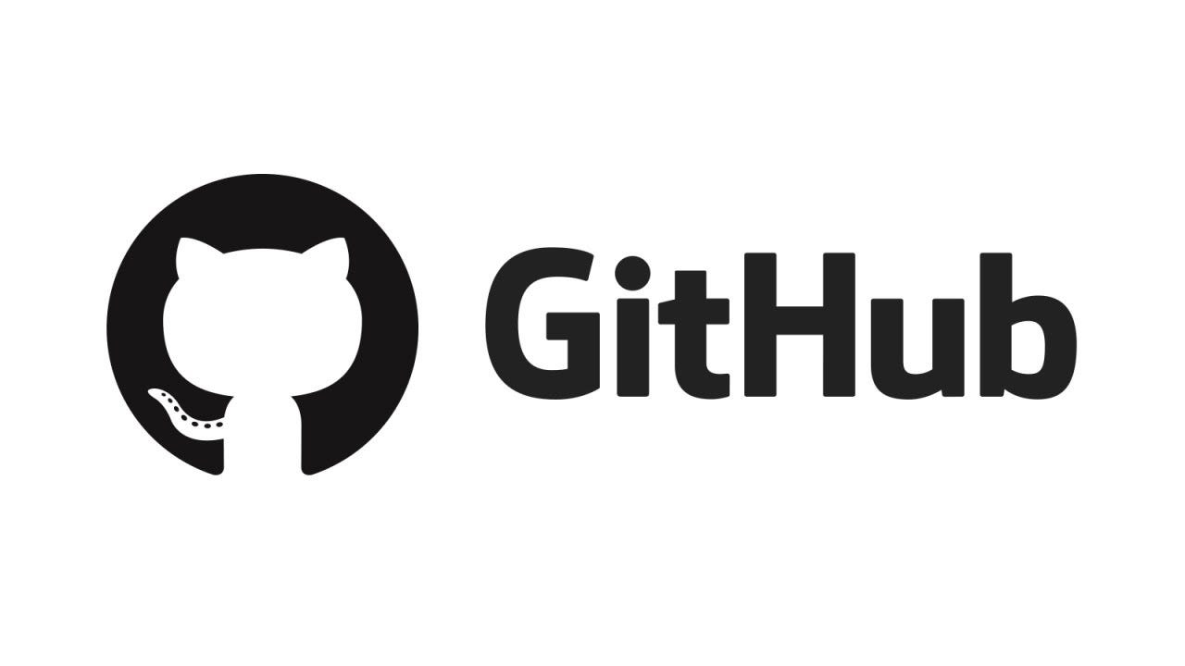

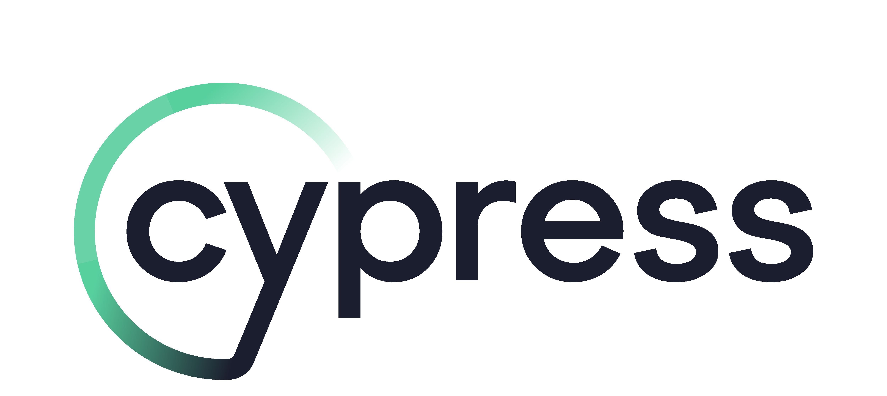
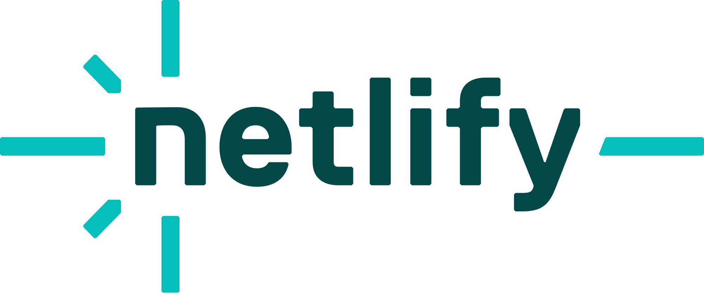
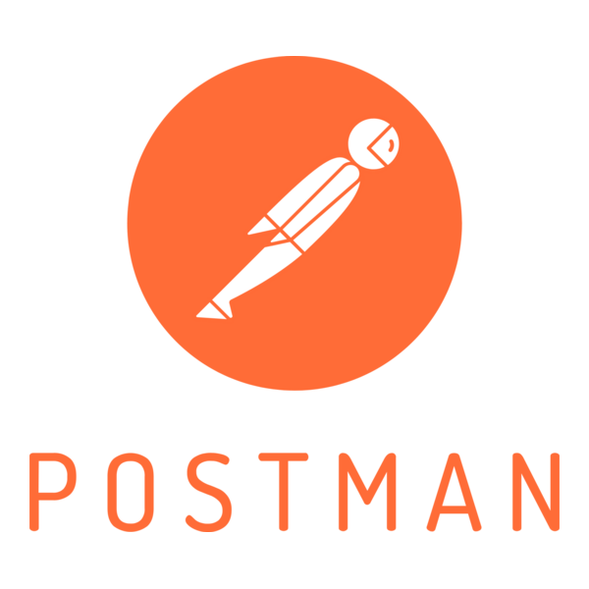

Implementation
Technologies Used
Frontend: Vue.js, Vuex, Material-UI, Chart.js
Backend: Node.js, Express.js, MongoDB, Mongoose
Testing: Postman, Jest, Cypress
DevOps: GitHub Actions, Netlify/Heroku, Glitch, Render

Slide 27

Testing & Debugging
Types of Testing Conducted
Unit Testing: Tested individual components (e.g., task creation, user authentication)
Integration Testing: Verified interaction between modules (e.g., frontend-backend APIs)
System Testing: Tested end-to-end workflows (e.g., project creation to task tracking)
User Acceptance Testing (UAT): Gathered feedback from end-users (developers, managers, clients)
Performance Testing: Evaluated system performance under load (100+ concurrent users).
Security Testing: Identified vulnerabilities (e.g., SQL injection, XSS)

Slide 28
Deployment & Hosting
Backend: Node.js + Express.js
Frontend: Vue 3 Composition API
Database: MongoDB (MongoDB Atlas)
Version Control: Gitbash, Github
Deployment Environment
Hosting Platforms
Frontend hosted on Netlify/Vercel
Backend deployed on Glitch/Render
MongoDB hosted on MongoDB Atlas (Cloud)
Environment variables configured securely
REST API connected to frontend
CORS and HTTPS enabled
Automatic CI/CD for frontend (Vercel)
Deployment Steps

Slide 29

Results & Findings
What The Software Achieves
Centralized Role-Based Project Platform
Real-Time Task and Progress Tracking
Secure Multi-Role Collaboration
Customizable Project and Task Dashboards
Integrated GitHub API Support
Stand-Up Documentation
Knowledge and Activity Preservation
Impact on Users & Industry
Increased Productivity
Improved Communication
Real-Time Project and Task Visibility
Enhanced Collaboration
Supports Remote and Distributed Teams
Preserves Project Knowledge and History
Improves Project Success Rates

Slide 30
Results & Findings
Comparison with Existing Solutions
Existing Solutions:
Use multiple disconnected tools
No real-time visibility or GitHub sync
Rigid workflows, limited flexibility
Generic, non-role-based dashboards
Weak collaboration features
Not ideal for distributed or small teams
Proposed System:
All-in-one platform
Real-time updates, GitHub sync, and chat
Flexible workflows for Agile, hybrid models
Role-based customizable dashboards
Built-in knowledge retention tools
Scalable for small to mid-sized teams

Slide 31
Limitations & Challenges
Limitations
Challenges
Not optimized for large-scale scalability
The backend hosting issue for free-tier limitations
No offline access or local caching
GitHub integration limited to PATs
Reporting features are basic
Subject to GitHub API rate limits
Limited cross-browser and accessibility testing
Synchronizing role-based permissions
Maintaining secure GitHub API integration
Managing task/project state in Vue 3 Composition API
Secure handling of file uploads and JWT tokens
Limited testing due to time and resource constraints
No built-in user onboarding or tutorials
Ensuring consistent UX for both technical and non-technical users

Slide 32
Conclusion & Future Work
Centralized platform for software project management
Solves key challenges faced by modern development teams
Enhances efficiency, transparency, and team accountability
Modern technology stack and user-centric design
Project Summary
Balancing diverse stakeholder requirements
Overcoming technical integration challenges
Encouraging user adoption and engagement
Handling tight development timelines and resource limits
Challenges & Lessons
AI-powered analytics and smart suggestions
Native mobile app development
Enhanced scalability for mid-sized teams
More customization options
Future Work

Slide 33
References
[1] I. Sommerville, Software Engineering, 10th ed. Boston, MA, USA: Pearson Education, 2015.
[2] K. Schwaber and M. Beedle, Agile Software Development with Scrum. Upper Saddle River, NJ, USA: Prentice Hall, 2002.
[3] K. Schwaber and J. Sutherland, The Scrum Guide: The Definitive Guide to Scrum, ScrumGuides.org, Nov. 2020. [Online]. Available: https://scrumguides.org/scrum-guide.html#scrum-definition.[Accessed: Jul. 1, 2025]
[4] Atlassian, “Jira Software Documentation: Project Tracking & Agile Boards,” 2023. [Online]. Available: https://support.atlassian.com/jira-software/. [Accessed: Jul. 1, 2025].
[5] Asana, “Asana Guide: Project Management and Team Collaboration,” 2023. [Online]. Available: https://asana.com/guide. [Accessed: Jul. 1, 2025].
[6] Trello, “Trello Documentation,” 2023. [Online]. Available: https://trello.com/guide. [Accessed: Jul. 1, 2025].
[7] ISO/IEC/IEEE 29119, Software and Systems Engineering – Software Testing, ISO/IEC/IEEE Int. Standard, 2013.[4] L. Bass, P. Clements, and R. Kazman, Software Architecture in Practice, 3rd ed. Boston, MA, USA: Addison-Wesley, 2012.
[8] S. W. Ambler, Agile Modeling: Effective Practices for Extreme Programming and the Unified Process. Hoboken, NJ, USA: Wiley, 2009.

Slide 34

Q&A / Thank You

